Slide 1
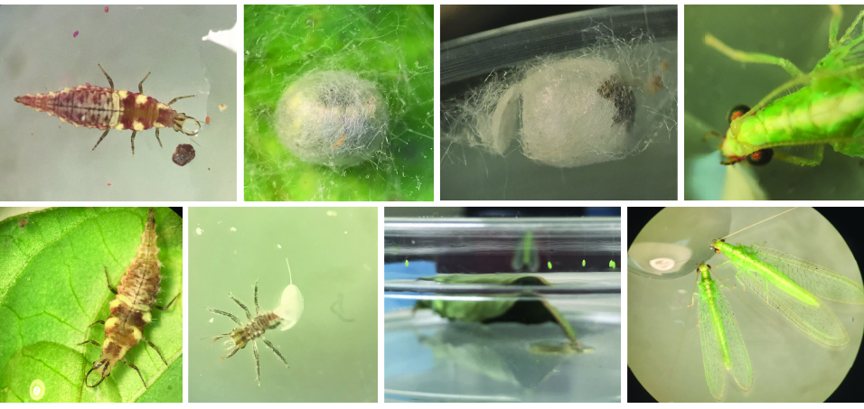
A
B
C
D
H
G
F
E
Figure S1. Rearing Chrysoperla rufilabris. Each individual of larval C. rufilabris was placed in each Petri dish and fed with eggs and nymphs of CMBS and 20 𝜇L-30 𝜇L droplets of artificial diet (Prosser and Douglas 1992) (A). After three larval stages, the third instars secreted silken cocoons to cover themselves to developed as pupae (B). Winged C. rufilabris adults emerged from the cocoons (C) and were reared using 20 𝜇L-30 𝜇L droplets of artificial diet and water (D). Several C. rufilabris adults were transferred into the same Petri dish supplemented with the artificial food for reproduction (E). Green eggs were laid on the lid of the Petri dish nearby the food (F). The 1st instar C. rufilabris hatched from the eggs (G) and provided with the artificial foods (H).

